Slide 1
TODO
Lada’s tests -> approval test (of the list) -> better printing
Full printed story -> whitespace -> json
Pretty printed json -> inline -> everywhere
everywhere -> single instance -> some can’t convert
dual conversations (.and) -> some can’t convert v2 -> setting state

Slide 2
Better Testing with Approvals
Llewellyn Falco
Lada Kesseler

Slide 3
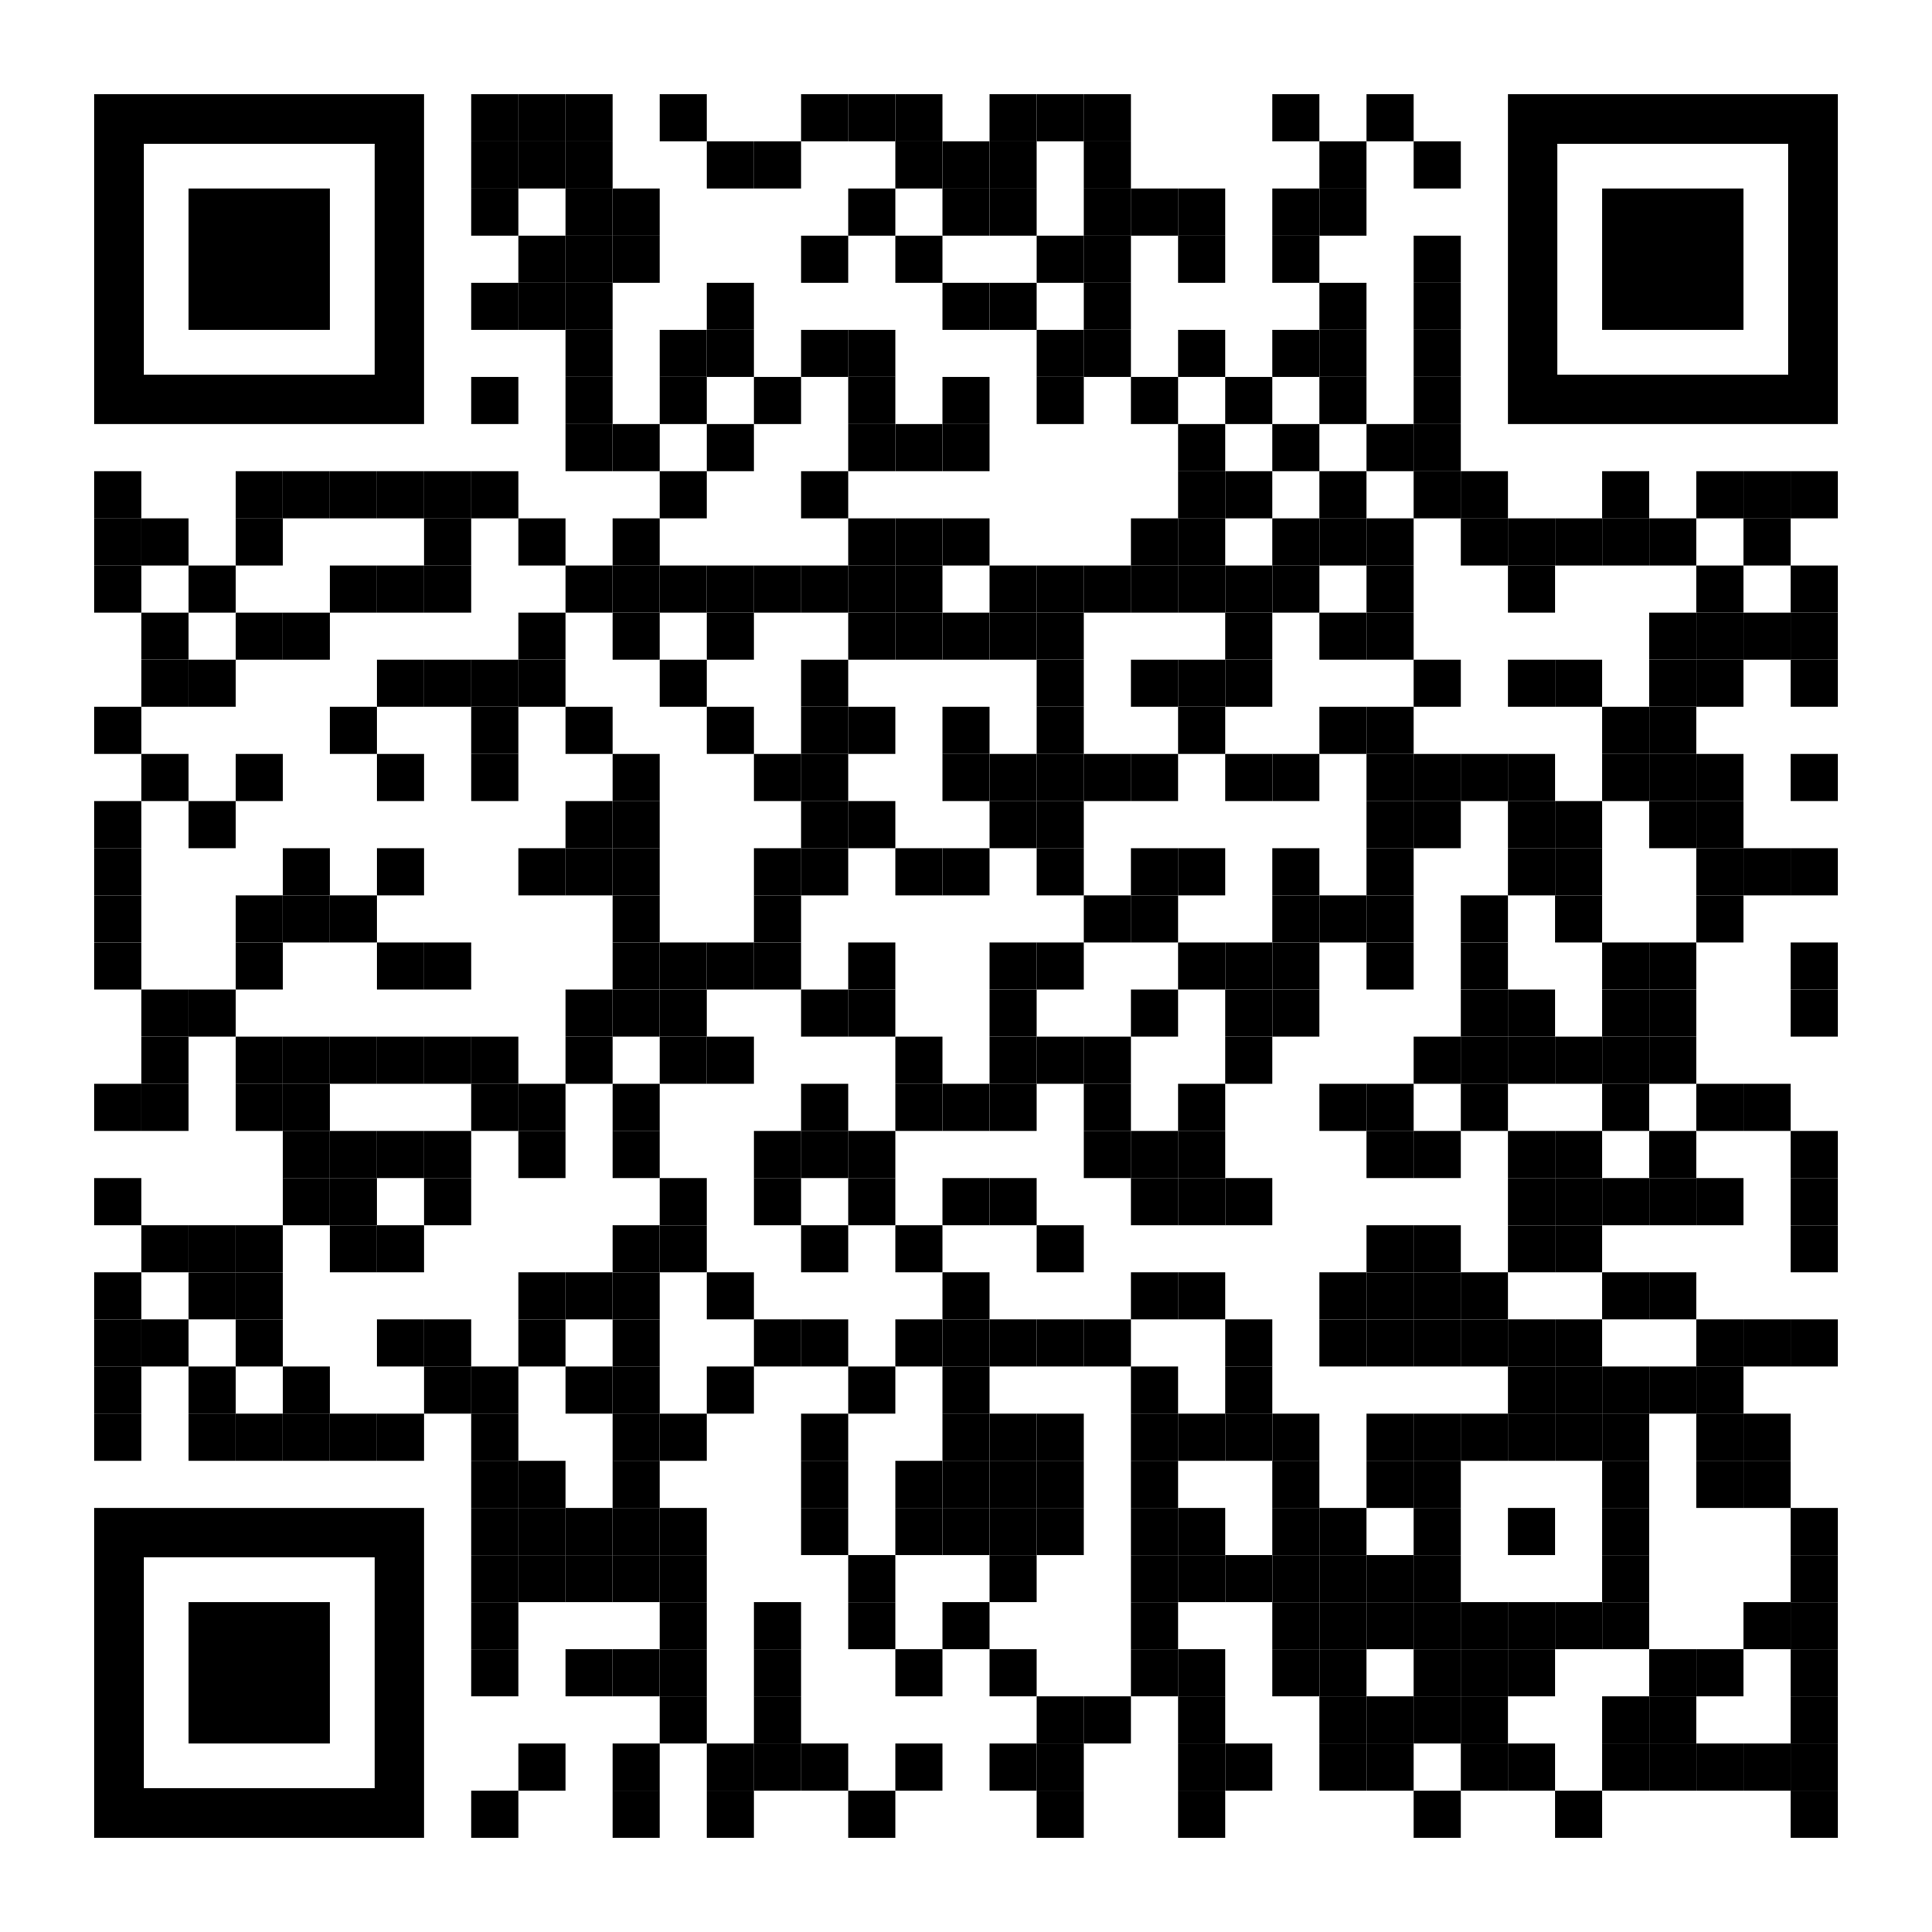
Resources
Notes:
https://github.com/isidore/Talks/blob/master/BetterTestingWithApprovals.md

Slide 4
“People don’t know what they want,
until they see what they don’t.”
- Alan Shalloway

Slide 5
The story so far
Lada: lead developer working on the message bot application
Llewellyn: technical coach working with Lada and work on some tests

Slide 6

In the beginning...

Slide 7
code

Slide 8
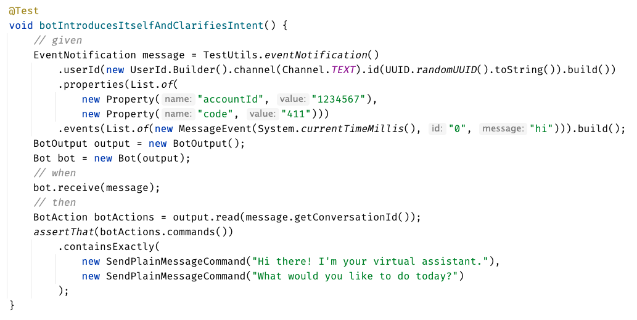
Original Test

Slide 9
?? WHAT IS THIS ??
Chat
[Customer]
hi
[Bot]
Hi there! I'm your virtual assistant.
What would you like to do today?

Slide 11
// Create side (0,0) – (3,4)
// Verify length
Whiteboard
English
Testing Circle
Result
Code
Side (0,0) – (3,4) length = 5
Side s = new Side(0,0,3,4);
Approvals.Verify(s + “ length = “ +s.Length);

Slide 12
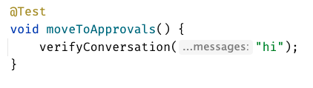

Chat
[Customer]
hi
[Bot]
Hi there! I'm your virtual assistant.
What would you like to do today?
Customer says ‘hi’
verify the conversation
English
Whiteboard
Result
Code

Slide 13
Chat
[Customer]
hi
[Bot]
Hi there! I'm your virtual assistant.
What would you like to do today?
Customer says ‘hi’
verify the conversation
English
Whiteboard
Result
Code
[Customer]: hi

Slide 14
Remember this:
Pay attention to the testing circle
Create convenience functions to hide unnecessary details
Notes:
Stay on the same level of abstraction as the testing circle

Slide 15
...later that week...

Slide 16
code

Slide 17
?? WHAT IS THIS ??
Chat
[Customer]
hi
[Bot]
Hi there! I'm your virtual assistant.
What would you like to do today?
[Customer]
pay bill
[Bot]
Are you a customer?
Yes, I'm a customer No, I'm not

Slide 18
Remember this:
Put extra work into your printers
Notes:
Stay on the same level of abstraction as the testing circle

Slide 19
Formatting
[Customer]: hi [Bot]: Hi there! I'm your virtual assistant. [Bot]: What would you like to do today?
[Customer]: hi [ Bot]: Hi there! I'm your virtual assistant. [ Bot]: What would you like to do today?

Slide 20
Formatting
[Customer]: hi [Bot]: Hi there! I'm your virtual assistant. [Bot]: What would you like to do today? [Customer]: hi [Bot]: Hmmm, tell me a little more so I can help you. What would you like to do today? [Customer]: hi [Bot]: Let me try to help you. [Bot]: Are you a customer? 1) Yes, I'm a customer 2) No, I'm not
[Customer]: hi [ Bot]: Hi there! I'm your virtual assistant. [ Bot]: What would you like to do today? [Customer]: hi [ Bot]: Hmmm, tell me a little more so I can help you. [ ]: What would you like to do today? [Customer]: hi [ Bot]: Let me try to help you. [ Bot]: Are you a customer? [ ]: 1) Yes, I'm a customer [ ]: 2) No, I'm not

Slide 21
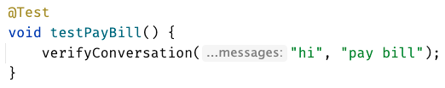
[Customer]: hi [ Bot]: Hi there! I'm your virtual assistant. [ Bot]: What would you like to do today? [Customer]: pay bill [ Bot]: Let me try to help you. [ Bot]: { "content": { "type": "vertical", "elements": [ { "type": "text", "text": "Are you a customer?", "tooltip": "text tooltip" }, { "type": "horizontal", "elements": [ { "type": "button", "title": "Yes", "click": { "actions": [ { "type": "publishText", "text": "Yes, I'm a customer" } ] } }, { "type": "button", "title": "No", "click": { "actions": [ { "type": "publishText", "text": "No, I'm not" } ] } } ] } ] } }

Slide 22
[Customer]: hi [ Bot]: Hi there! I'm your virtual assistant. [ Bot]: What would you like to do today? [Customer]: pay bill [ Bot]: Let me try to help you. [ Bot]: Are you a customer? [ ]: 1) Yes, I'm a customer [ ]: 2) No, I'm not

Slide 23
...later that week...

Slide 24
code

Slide 25
Remember this:
If the output is small, use inline approvals
Notes:
Stay on the same level of abstraction as the testing circle

Slide 26
// Create side (0,0) – (3,4)
// Verify length
Whiteboard
English
Testing Circle
Result
Code
Side (0,0) – (3,4) length = 5
Side s = new Side(0,0,3,4);
Approvals.Verify(s + “ length = “ +s.Length);

Slide 27
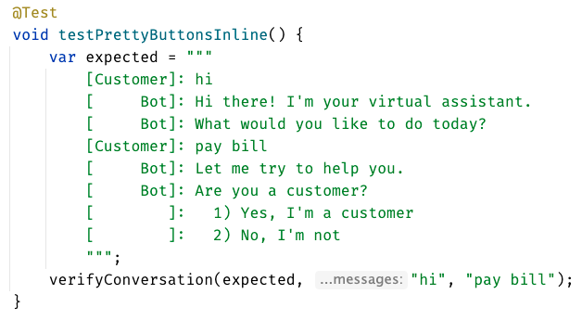
inline - everything in test

Slide 28
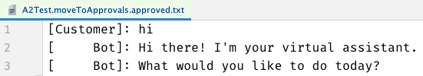
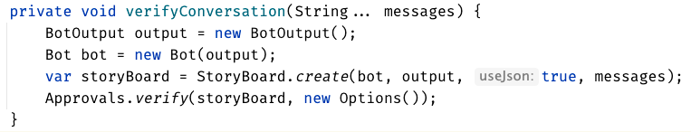

Slide 30
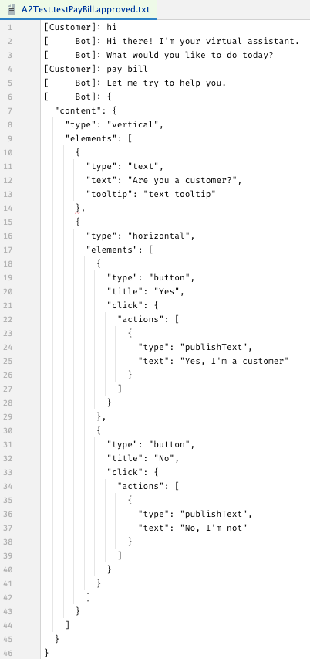

Slide 31
...later that week...

Slide 32
code
Notes:
Hey Llewellyn, look what I did

Slide 33
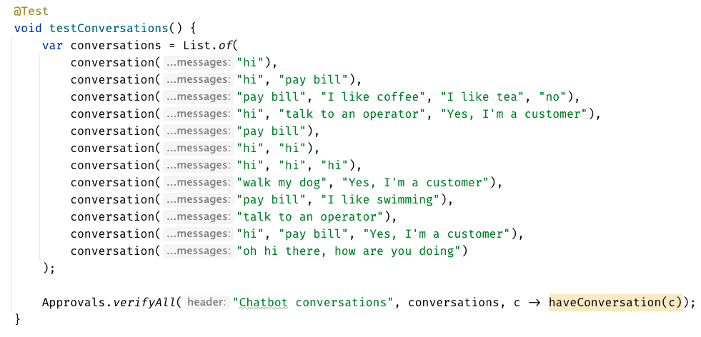

Slide 34
Remember this:
When you have a lot of similar scenarios, allow yourself to see both the forest and the trees
Notes:
Stay on the same level of abstraction as the testing circle

Slide 35
...later that week...

Slide 36
code
Notes:
Hey Llewellyn, look what I did

Slide 37
Remember this:
Invest in APIs that make it easier to express test scenarios
Notes:
Stay on the same level of abstraction as the testing circle

Slide 38
can see only
up to here
foggy
as the details disappear,
we get to see the next layer
person

Slide 39
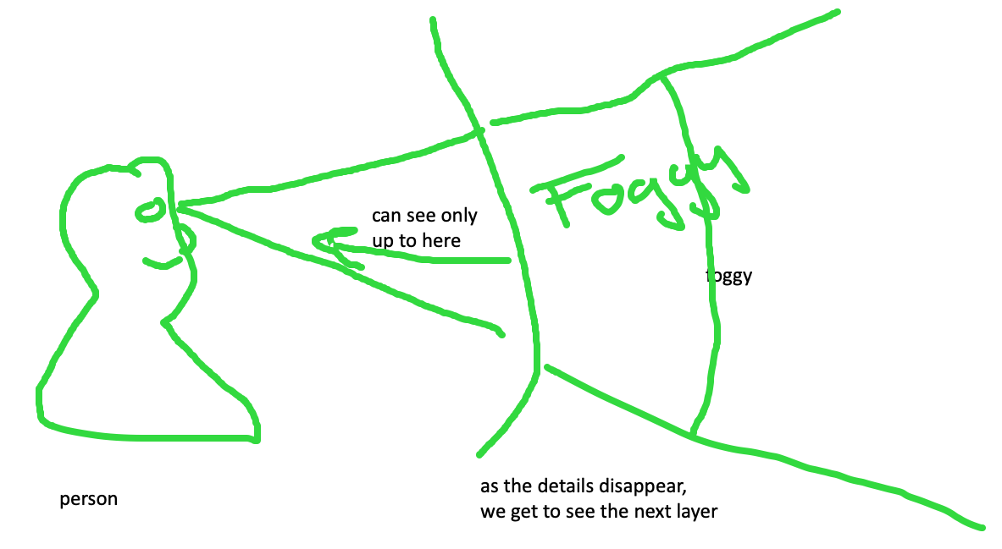
feedback loop – too hard and impossible is the same thing, stop to look

Slide 40
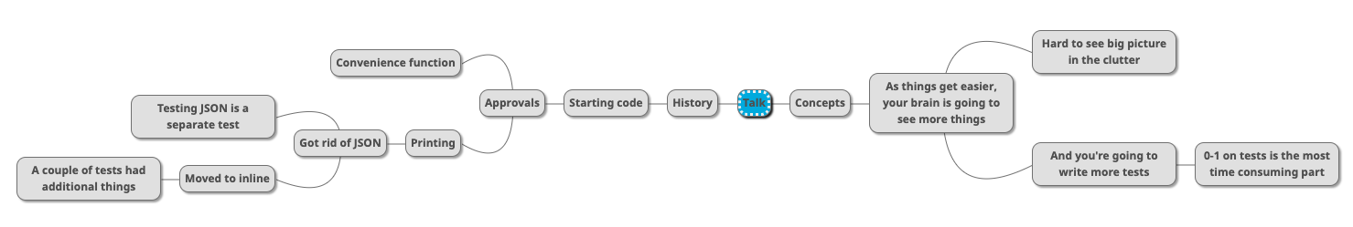

Slide 42
Rest Calls

Slide 43
Consider paths we took:
wordy Java tests
made a printer
made a good printer – not a json: Json test // TODO the json tests
made the inlining – makes it easier to read the whole test better
did multiple conversations
now we can see individual tests, but we can’t see the big picture – so we moved it to the uber test – can delete the other files

Slide 44
Original
@Test public void shouldGetCustomerFromService() { // given accountType = CustomerAccountTypeInfo.builder().account(ACCOUNT_ID).accountType(”PERSONAL").subscription(”MONTHLY").build(); when(responseEntity.getBody()).thenReturn(accountType); // when CustomerAccount result = customerService.retrieveAccount(ACCOUNT_ID); // then CustomerAccount expectedCustomerAccount = new CustomerAccount(ACCOUNT_ID, CustomerPaymentType.MONTHLY, "PERSONAL"); assertThat(result, is(expectedCustomerAccount)); verify(restTemplate, times(1)).exchange(calledUrlCaptor.capture(), eq(HttpMethod.GET), sentHttpEntityCaptor.capture(), any(Class.class)); verifyHeadersAreValid(sentHttpEntityCaptor.getValue().getHeaders()); }

Slide 45
Approval Text
Recorded call to : Conversation Details API
REQUEST
--------------------------------------------------------------------------------
Method : GET
Called Url: /api/v1.2/message/id/500
Headers :
{
"Authorization" : [ "Basic fake" ],
"Cache-Control" : [ "no-cache" ]
}
Body :
null
EXAMPLE RESPONSE
--------------------------------------------------------------------------------
{
"data": [
{
"displayNumber": "500",
"encodedCaseDisposition": 27,
"uuid": "uuid-1",
"createDate": 0,
"responsePortalLink": "/portal/message/500",
"primaryMessage": {
"conversationDisplayId": "500",
"network": "twitter",
"networkInstance": "twitter",
"receiveDate": 0,
"publishDate": 0,
"tags": [
],
"private": true
},
"messages": [
{
"conversationDisplayId": "500",
"network": "twitter",
"networkInstance": "twitter",
"receiveDate": 0,
"publishDate": 0,
"tags": [
],
"private": true
}
],
"tags": [
{
"creator": {
"type": "BOT"
},
"tagId": "34",
"uuid": "uuid2"
}
],
"priority": 4,
"lswPermalink": "/console/bot/500",
"totalResponses": 2,
"hasResponse": false,
"status": "IN_PROGRESS"
}
]
}

Slide 46
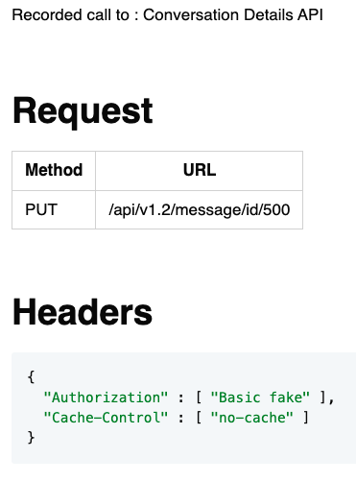
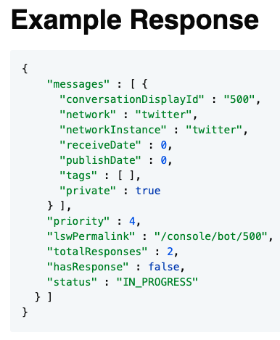
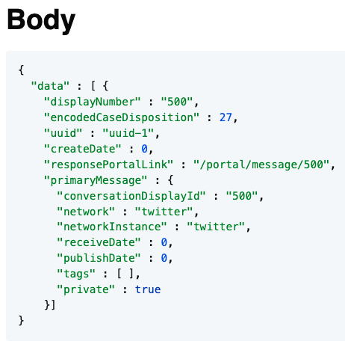
Approval Markdown
2-5 min - Lightning talk?

